Slide 1




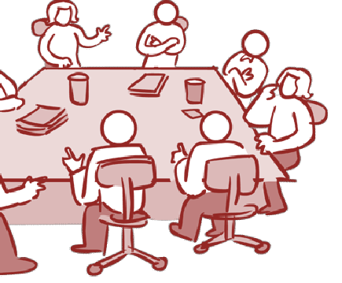








Requirement Engineering
Unit 2.2 Inception & Elicitation
Requirement Analysis & Specification

Slide 2


Requirements Engineering Tasks
1
Inception
Roughly define scope
A
basic understanding of a problem, people
who want solution, the
nature of solution
a
a e
desired
At project inception, you establish a basic understanding of the problem, the people who want solution, the nature of the solution that is desired, and the effectiv ness of preliminary communication and collaboration between the ther stakeholders and the software team.
Feasibility Study is a crucial phase in software development

Slide 3
Project Inception
During the initial project meetings, the following tasks should be accomplished
Identify the project stakeholders
These are the folks we shoul be talking to
Recognize multiple viewpoint
Stakeholders may have different (and conflicting) requirements
Work toward collaboration
It’s all about reconciling conflict
Ask the first questions
d
s
Who? What are the benefits? Another source?
What is the problem? What defines success? Other constraints?
•
Am I doing my job right?

Slide 4
Feasibility Study
Is cancellation of a project a bad news?
As per IBM report, “31% projects get cancelled before they are completed, 53% over-run their cost estimates by an average of 189% & for every 100 projects, there are 94 restarts
How do we cancel a project with the least work?
CONDUCT A FEASIBILTY STUDY

Slide 5
Feasibility Study
Technical feasibility
Is it technically feasible to provide direct communication connectivity through space from one location of globe to another location?
Is it
technically feasible to design a programming
language using “Sanskrit”?

Slide 6
Feasibility Study
Feasibility depends upon non technical Issues like:
Are the project‟s cost and schedule assumption
realistic?
Does the business model realistic?
Is there any market for the product?

Slide 7
Feasibility Study
Purpose of feasibility study
“evaluation or analysis of proposed project or program ”
the potential impact of a
Focus of feasibility studies
Is the product concept viable
Will it be possible to develo a
?
p
product that matches the
project‟s vision statement?
What are the current estimated
cost and schedule for the
project?

Slide 8
Feasibility Study
Focus of feasibility studies
How big is the gap between the original cost & schedule targets & current estimates?
•
Is the business model for software justified when the current cost & schedule esti ate are considered?
m
Have the major risks to the project been identified
& can
they be surmounted?
Is the specifications complete & stable enough to support remaining development work?

Slide 9


Requirements Engineering Tasks
2 Elicitation (Requirement G thering)
Define requirements
The practice of collecting the requirements of a system from users, customers and other stakeholders
a
In requirements engineering, requi ements elicitation is the practice of researching and discovering the re uirements of a system from users, customers, and other stakeholders. The practice is also sometimes referred to as "requirement gathering".
r
q

Slide 10
Component of Require ents elicitation
m
Requirements Elicitation
Application Domain
Problem to be solved
Stakeholder
Business context
needs and constraints

Slide 11
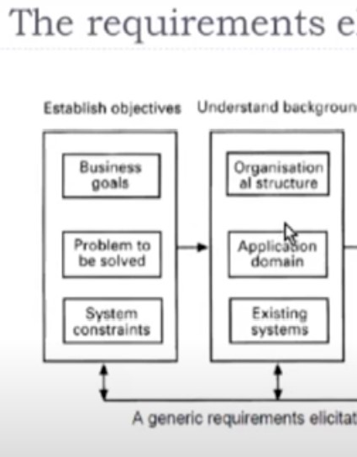
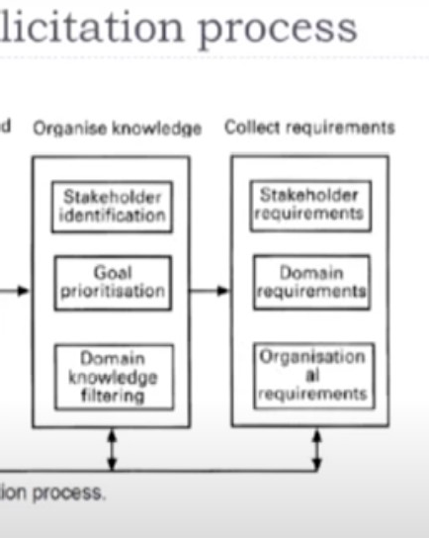

Slide 12




Elicitation is the Hardest Part!
Problems of scope
System boundaries are ill-defi ed
Customers will provide irrelevant information
Problems of understanding
Customers never know exactly what they want
Customers don’t understand capabilities and limitations
Customers have trouble fully communicating needs
Problems of volatility
Requirements always change
It certainly seems simple enough—ask the customer, the users, and others what the objectives for the system or product are, what is to be accomplished, how the system or product fits into the needs of the business, and finally, how the sys- tem or product is to be used on a day-to-day basis. But it isn’t simple—it’s very hard.
n

Slide 13


Requirements Elici ation
t
Perhaps
Most difficult
Most critical
•
•
Most error prone communication
Most intensive
Succeed
effective custo
m
er developer partnership

Slide 14




Collaborative Elicitation
◻ One-on-one Q &A sessions rarely succeed in practice; collaborative strategies are more practical

Slide 15

Requirements Elicitation
1 Interviews
Both parties
--- open ended
--- structured
have a common goal
Interview
Success
of the project
Selection of stakeholder
Entry level personnel
Middle level stakeholder
Managers
Users of the software (Most
important)

Slide 16


Requirements Elicitation
Types of questions
Any problems with existing system
Any Calculation errors
•
Possible benefits
Satisfied with current policies
How are you maintaining the records?
Any requirement of data from other system
Any additional functionality
Most important goal of the proposed Development
Possible reasons for malfunctioning
At the end, we may have wide variety of expectation from the proposed software

Slide 17



Requirements Elicitation- Brainstorming
It is a group technique
group discussions
New ideas Quickly Creative Thinking
Prepare long list of requirements
Categori ed Prioritized Pruned
z
*Idea is to generate views ,not to vet them Groups
1 Users 2 Middle Level managers 3
Total Stakeholders

Slide 18
Requirements Elicitation
A Facilitator may handle group bias, conflicts carefully
-- Facilitator may follow a published agenda
⁻⁻ Every idea will be documented in a way that everyone can see it.
--A detailed report is prepared
3 Facilitated Application specification Techniques (FAST)
-- Similar to brainstorming sessions
-- Team oriented approach
-- Creation of joint team of customers and developers

Slide 19
Requirements Elicitation
Guidelines
Arrange a meeting at a neutral site
Establish rules for participation
Informal agenda to encour ge free flow of ideas
Appoint a facilitator
Prepare definition mechanism board, worksheets, wall stickier
Participants should not criticize or debate
FAST session Preparatio s
Each attendee is asked to make a list of objects that are:
a
n

Slide 20
Requirements Elicitation
Activities of FAST session
Every participant presents his/her list
Combine list for each topic
Discussion
Consensus list
Sub teams for mini specifications
Presentations of mini-specifications
Validation criteria
8. A sub team to draft specifications

Slide 21

Requirements Elicitation
4 Quality Function De loyment
p
- Incorporate voice of the customer
Technical requireme ts Documented
Prime concern is customer satisfaction
What is important for customer?
-- Normal requirements (Explicit)
-- Expected requirements (Implicit)
-- Exciting requirements

Slide 22
Quality Function Deployment (QFD)
◻ This is a technique that translates the needs of the customer technical requirements for software
into
◻ It emphasizes an understanding of what is valuable to the
the
customer and then deploys these values throughout
engineering process through functions, information, and tasks
It identifies three types of requirements
Normal requirements: These requirements are the objectives and goals stated for a product or system during meetings with the customer
Expected requirements: These requirements are implicit to the product or system and may b so fundamental that the customer does not explicitly state them
Exciting requirements: These requirements are for features that go beyond the customer's expectations and prove to be very satisfying when present

Slide 23

Elicitation work products
Collaborative elicitation should result in several work products
Abounded statement of scope
Alist of stakeholders
A description of the technical environment
A list of requirements and constraints
•
Any prototypes developed
A set of use cases
Characterize how users
will
interact with the system
Use cases tie requirements together
functional

Slide 24
Requirements Elicita ion - Steps
t
Steps
Identify stakeholders
List out requirements
3 Degree of importance
to each requirement

